Slide 1

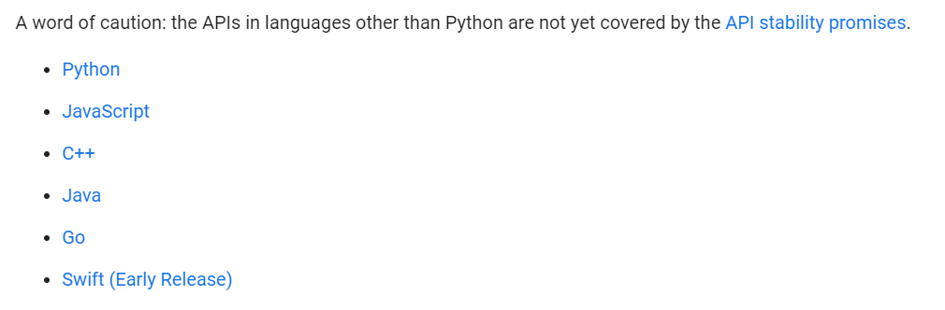


Questions from Students
Other than using TensorFlow, Keras, Colaboratory what other software can we use to create the Pokemon classifier?
Tensorflow in other languages:
https://www.tensorflow.org/api_docs
Another platform for writing Python:
Another deep learning library:

Slide 2
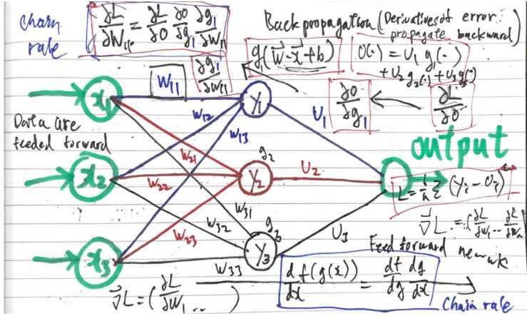
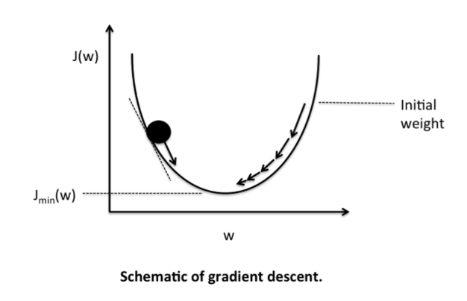
Questions from Students
I would like to know more about backward propagation. From my understanding, backward propagation is for minimizing the lost function. However, how does it work?
Backward propagation
(Stochastic) Gradient Descent

Slide 3
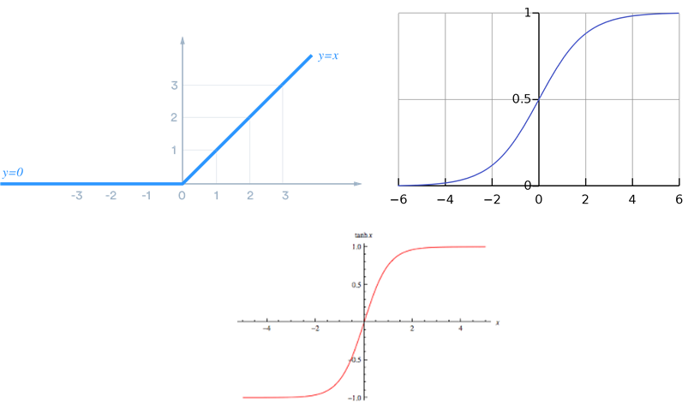
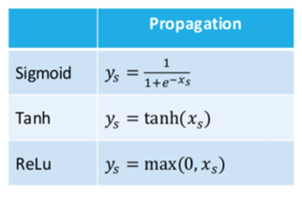
Questions from Students
How do we decide when to use "Sigmoid", "Tanh" or "ReLu"?
ReLu
Sigmoid
Tanh

Slide 4
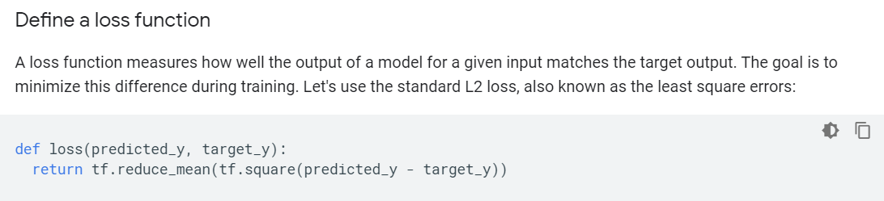
Questions from Students
The code for the model is really really short here. In the past when I was learning deep learning, I usually write some chunks of code like the implementation of Adam. Do you think we should write common layers/processes out from scratch at least once before using the library's function? Do people in the industry use library functions or write their own? (because I know people on the two extremes and no one in between)
Custom training in TensorFlow:
https://www.tensorflow.org/tutorials/customization/custom_training

Slide 5
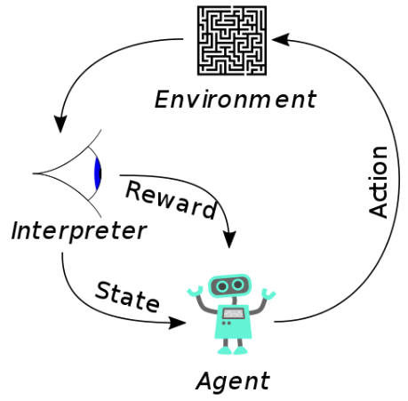
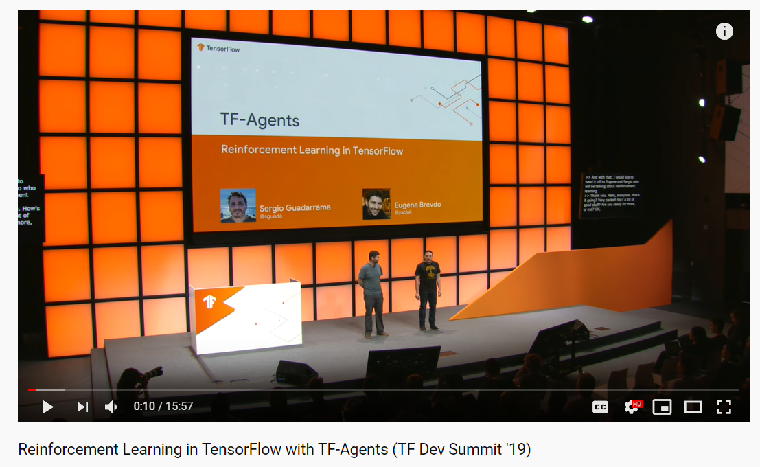
Questions from Students
If I would like to make an AI that are not graphics but more on logic or math (e.g. puzzles or games), is there any special code that I need to know to work on that?
Reinforcement learning in TensorFlow: https://www.youtube.com/watch?v=-TTziY7EmUA

Slide 6
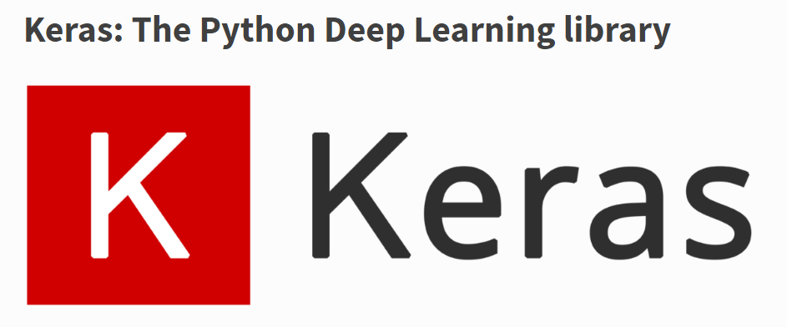
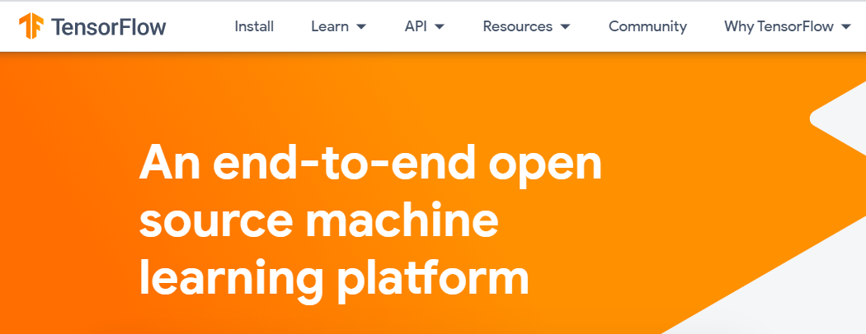
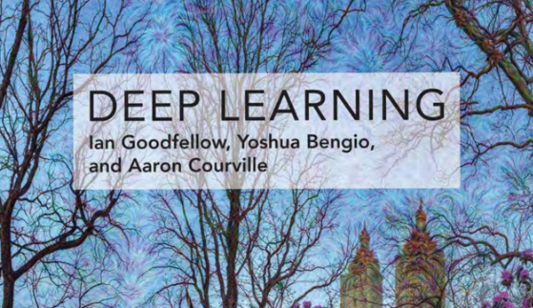
Questions from Students
How can I find more information for my code when I have problems in the future (e.g. recommended websites, books, etc.)?
Keras documentation:
https://keras.io/
TensorFlow official website:
https://www.tensorflow.org/
Free deep learning book: https://www.deeplearningbook.org/

